Slide 1
THEORY OF COMPUTATION IN ARTIFICIAL INTELLIGENCE
Theory of Computing

Slide 2


GROUP MEMBERS
01
Munia Akter MIM 232-35-187
05
Click-Through Rate (CTR)
₀₂ Customer Lifetime
Value (CLV)
03 Conversion Rate
04
Return on Investment (ROI)

Slide 3

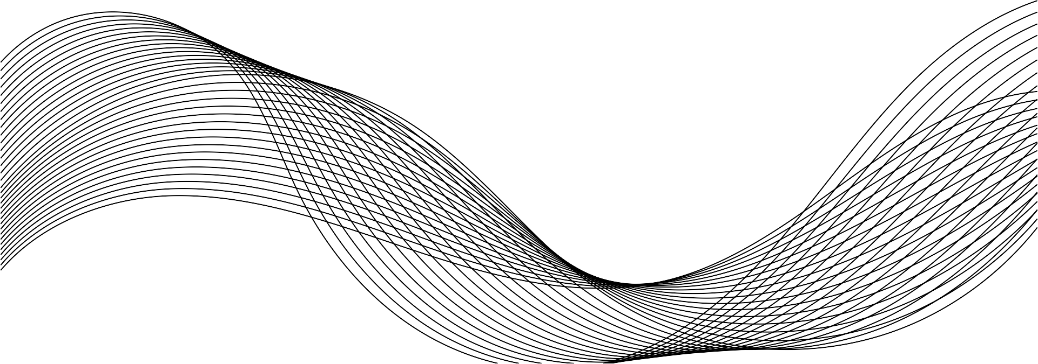
What is the Theory of Computation?
Definition: Study of abstract machines and problems they can solve
Core areas: Automata theory, formal languages, computability, complexity
Importance: Forms the foundation of computer science and AI

Slide 4

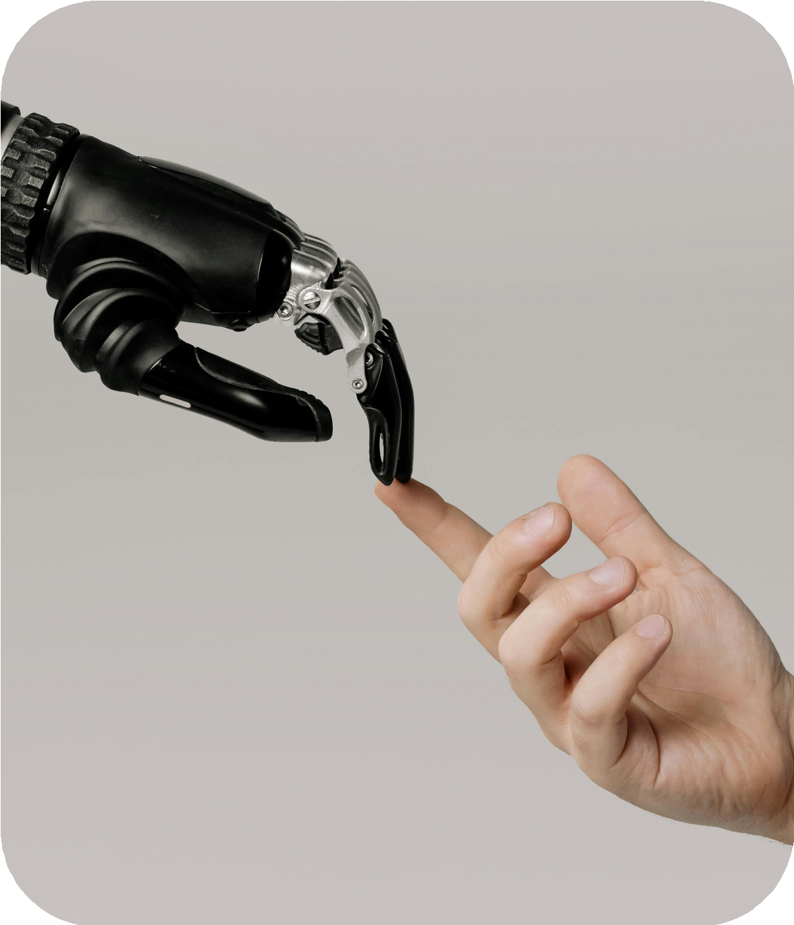
Understanding
Artificial Intelligence
Definition: Machines simulating human intelligence
Key capabilities: Learning, reasoning, perception, language understanding
AI disciplines: Machine learning, NLP, robotics, etc.

Slide 5



Why ToC Matters in AI?
Defines limits of what AI can compute
Helps design efficient algorithms for AI
Informs decidability and tractability in machine learning and reasoning tasks

Slide 6

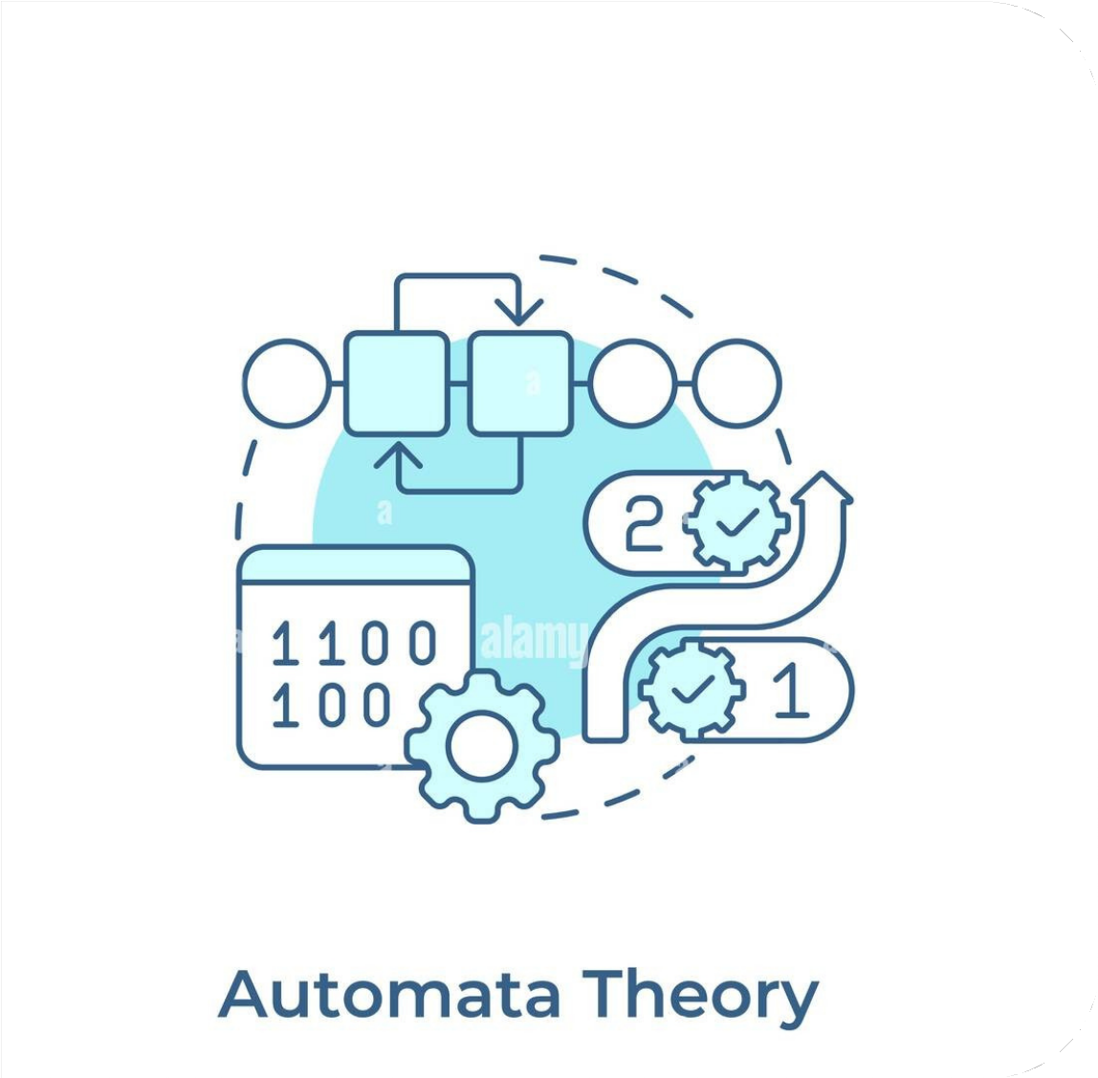
Automata Theory Applications in AI
Finite automata: Useful in pattern recognition, lexical analysis
Pushdown automata: Model syntactic parsing in NLP
Turing machines: Abstract model of any computable function

Slide 7

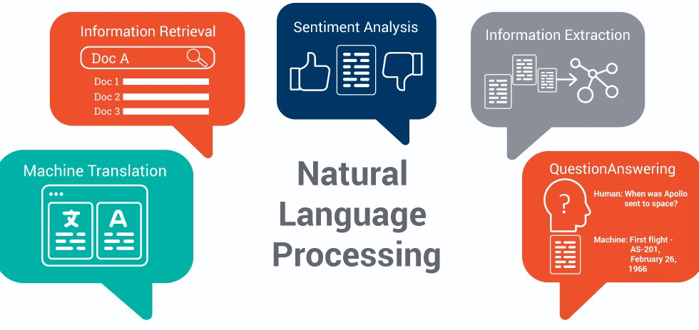
Role of Formal Languages in AI
Used in NLP and knowledge representation
Grammar and syntax modeling
Helps define structured data formats for AI learning

Slide 8


Computability and Decidability in AI
In AI, some problems are decidable, meaning they can be solved by algorithms in finite time—like pathfinding or classification. Others are undecidable, such as the Halting Problem, which require restricted models or heuristics since no algorithm can solve them in all cases.
Decidable – Pathfinding, classification, logic with limits – Fully solvable with correct algorithms.
Undecidable – Halting Problem, full logical entailment – Requires restricted models or heuristics.

Slide 9

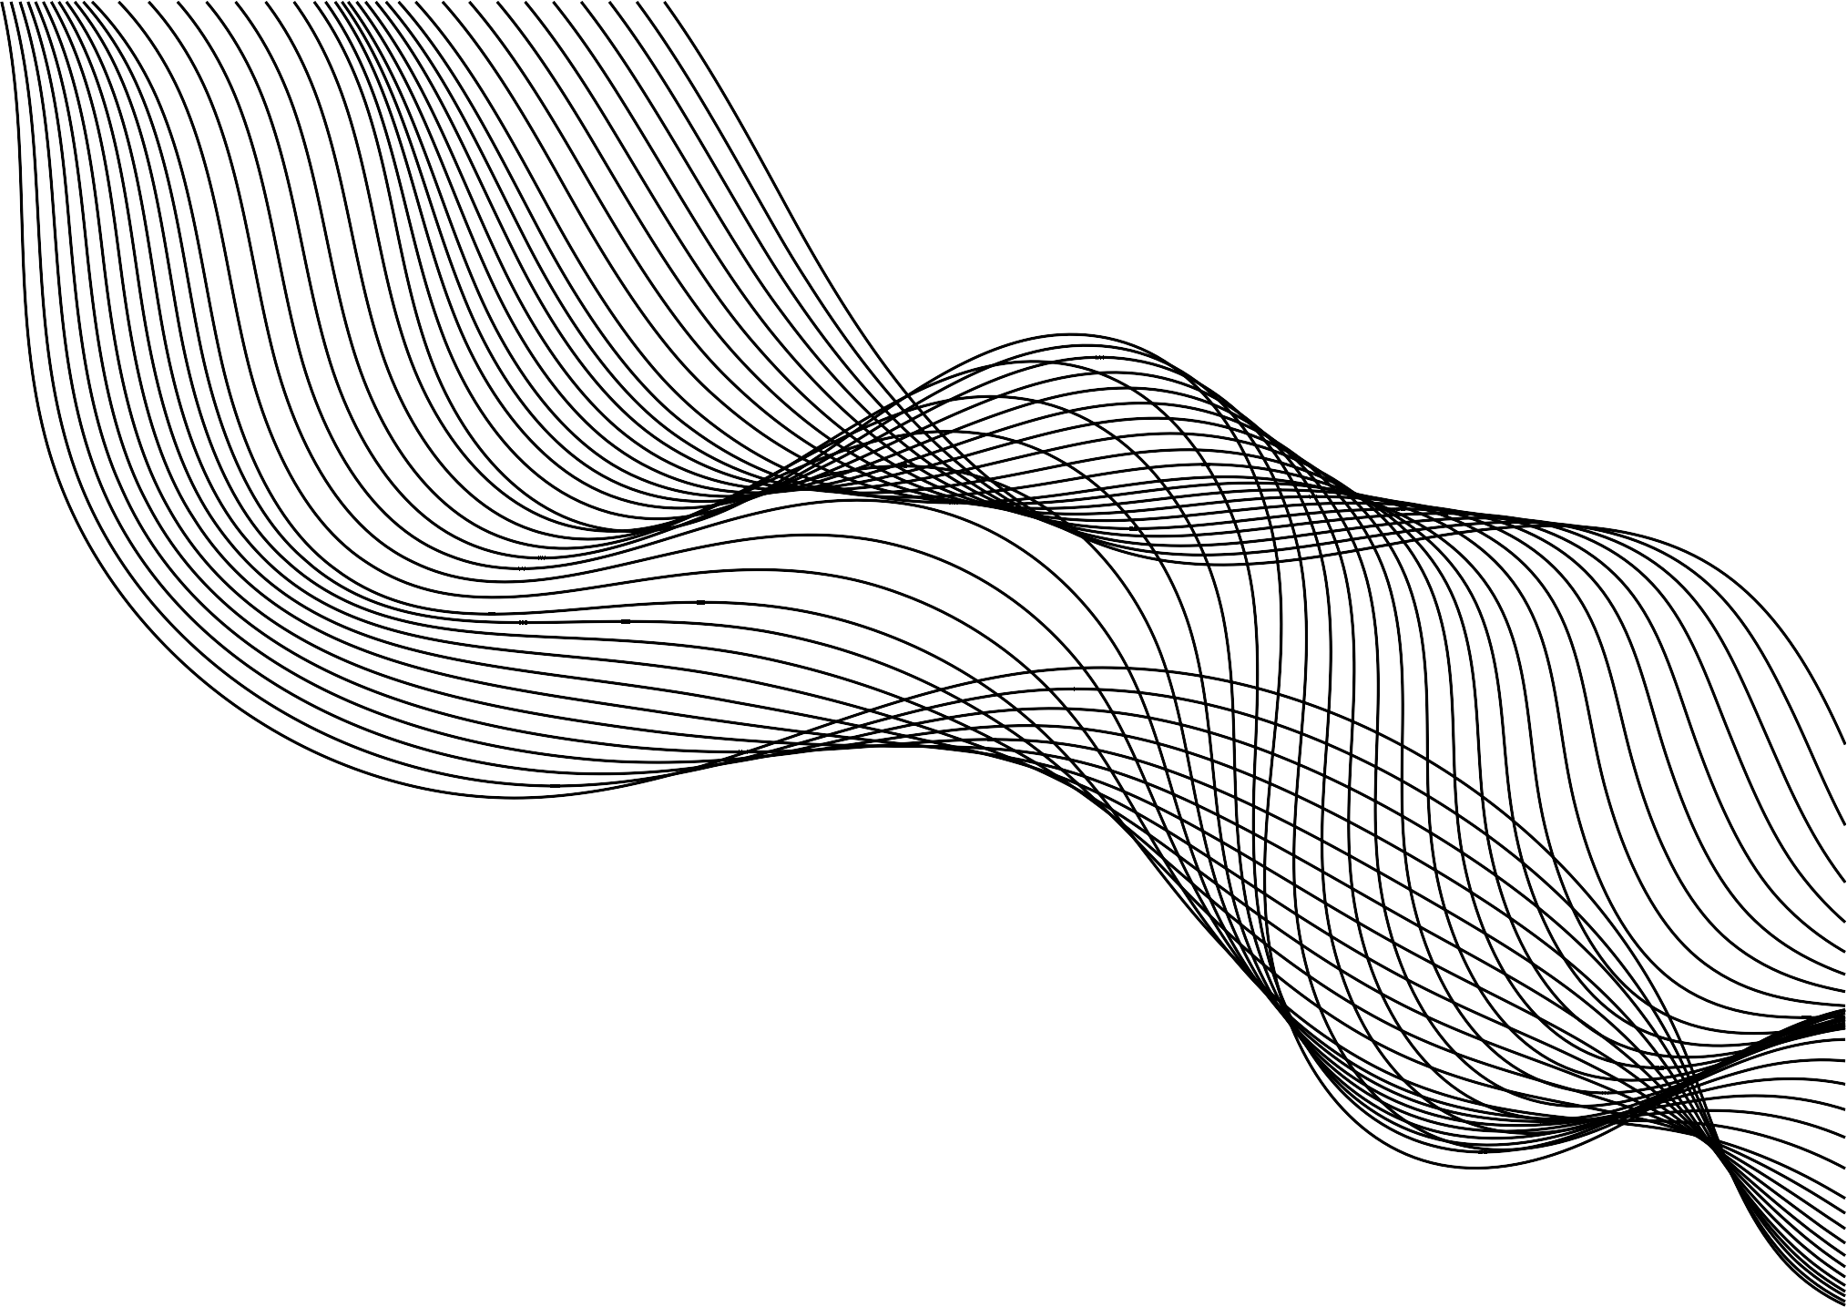
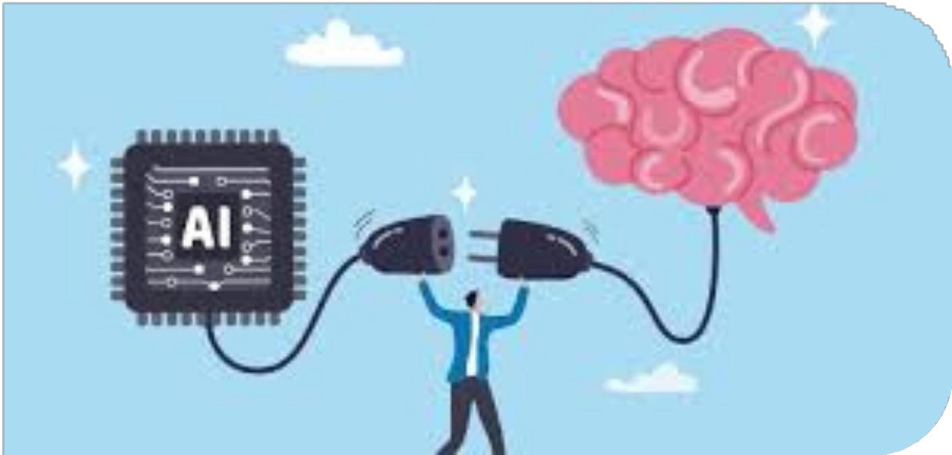
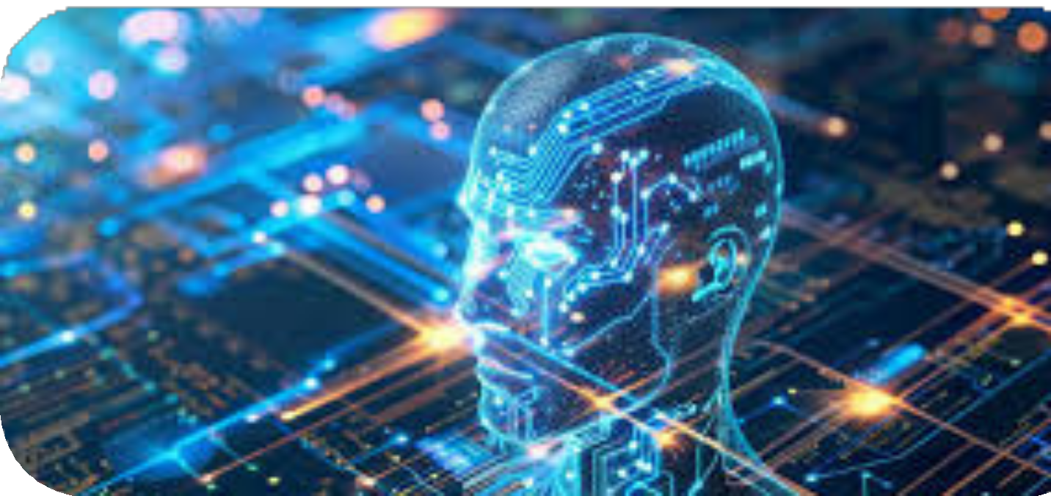
Computational Complexity and AI
Classifying problems: P, NP, NP-complete
Optimization and search problems in AI
Helps assess scalability and performance

Slide 10
₀₁ •Propositional and
LOGIC SYSTEMS IN AI AND TOC
02
Inference mechanisms and theorem proving
predicate logic
03
Decidability and logical inference

Slide 11
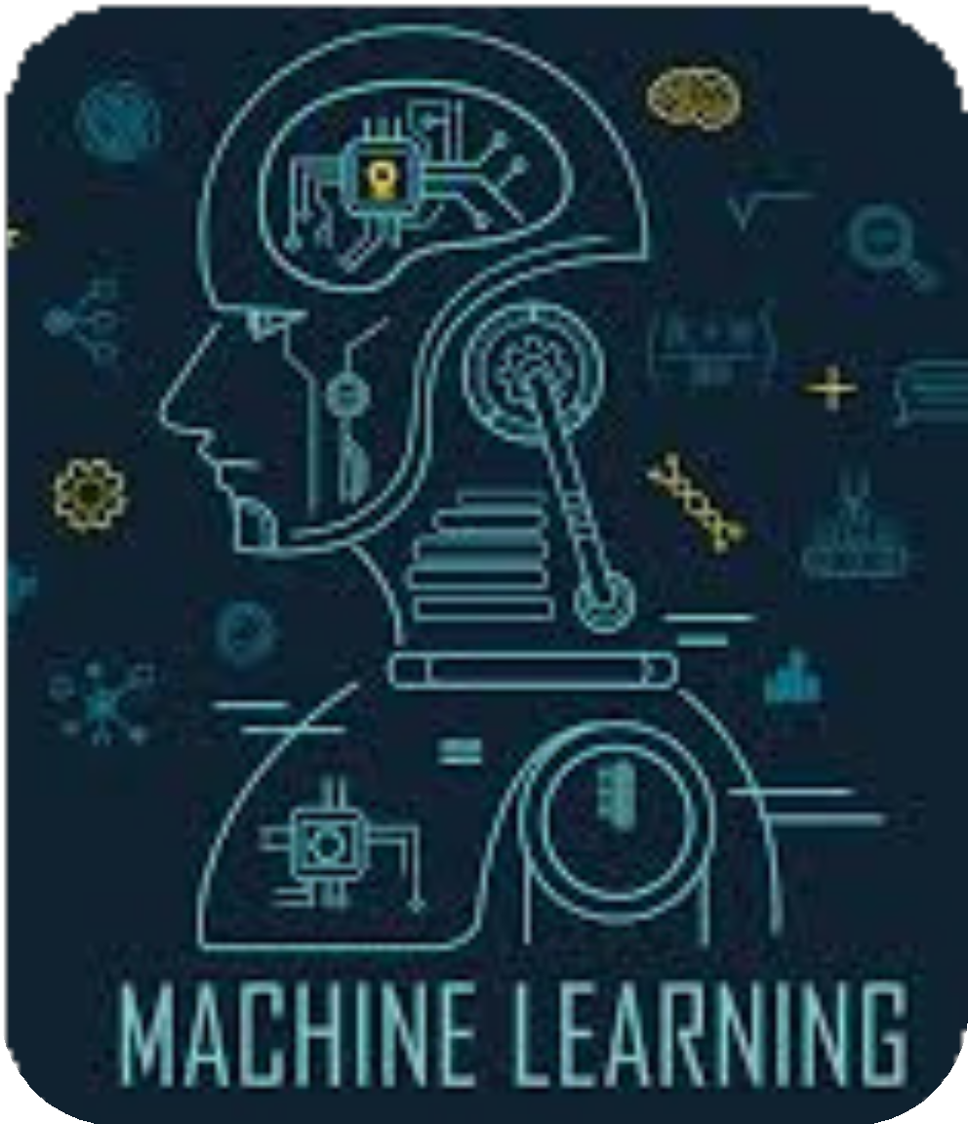
Machine Learning Foundations and ToC
Learning as a computational process
PAC learning (Probably Approximately Correct)
Limits of learnability

Slide 12

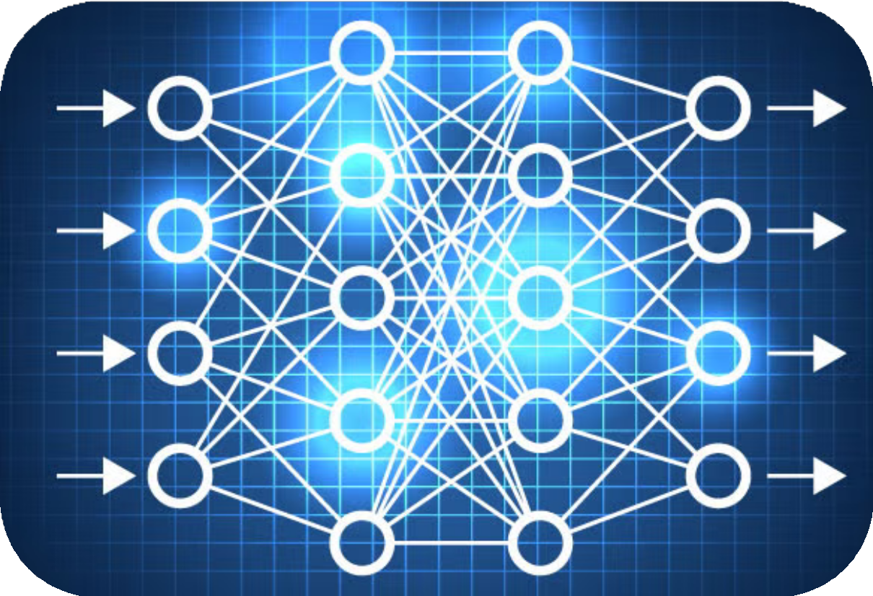
Neural Networks & Automata Models
Neural networks as universal approximators
Analogies with Turing machines
Memory limitations vs infinite tape in Turing machines

Slide 13
CHALLENGES AND FUTURE OF TOC IN AI
01 Challenges
Scalability vs. Theory: ToC offers guarantees; AI prefers empirical performance.
Intractability: Many AI tasks
are NP-hard; heuristics dominate practice.
Black-box Models: Neural networks lack interpretability, hard to model with ToC tools.
Data-Centric AI: Modern AI relies on data, while ToC is model-centric.
₀₂ Future Directions
Learning Theory: Extend PAC, VC-dimension to deep learning.
Efficient Algorithms: Use ToC
to guide scalable AI solutions. Formal Verification: Prove safety, robustness, and fairness.
Neuro-Symbolic Systems: Combine symbolic logic with
deep learning.
New Computation Models: Rethink computation beyond Turing machines.

Slide 14

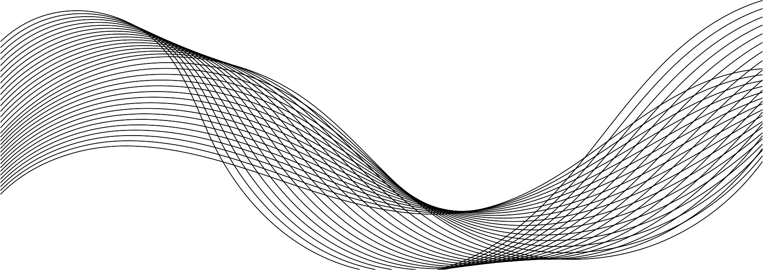
Conclusion
Theory of Computation (ToC) is key to understanding the limits and possibilities of AI. While AI often focuses on data and performance, ToC ensures reliability, efficiency, and trust. Future progress in AI will rely on closer integration with strong theoretical foundations.

Slide 15




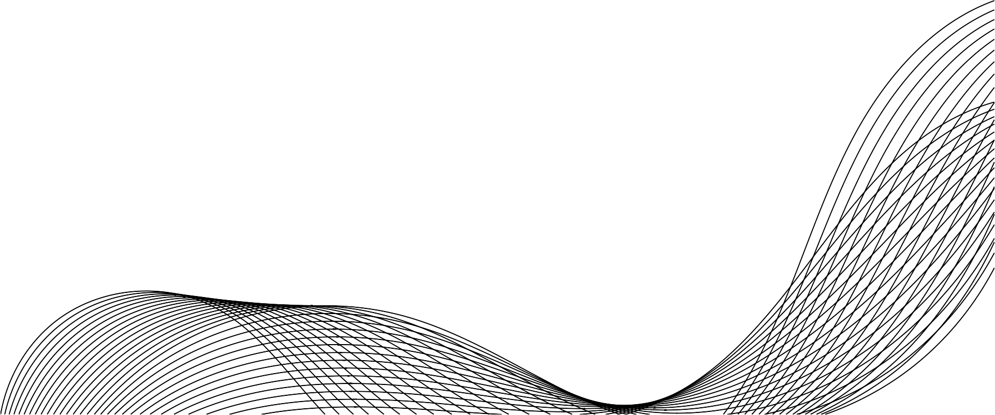
THANK YOU
ANY QUESTION?

